Slide 1
Union/Management Issues
©William Klinger. This work is licensed under a Creative Commons Attribution 4.0 license
Adapted from Fundamentals of Business
Download this book for free at: https://vtechworks.lib.vt.edu/handle/10919/84848

Slide 2
Review
What planning does HR do?
Name alternative work arrangements.
Explain how managers evaluate employee performance and retain qualified employees.
What is the difference between a defined benefit plan and a defined contribution plan?

Slide 3
Learning Objectives
Explain why workers unionize and describe the collective-bargaining process
Discuss key terms associated with union/management issues, such as mediation and arbitration.
Identify the tactics used by each side to support their negotiating positions: strikes, picketing, boycotting, and lockouts.
Adapted from Fundamentals of Business
Download this book for free at: ttp://hdl.handle.net/10919/70961

Slide 4
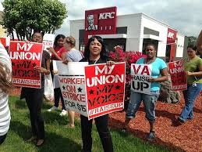
Motivations to Unionize
Good pay
Good, safe working conditions
Sufficient benefits
Unified management interface
Job security

Slide 5
Union Structures
Locals
Shop stewards
Union presidents
National unions
Made up of local unions
Labor Federation
Group of national unions
E.g. AFL-CIO

Slide 6
Collective Bargaining
Collective bargaining agreement (CBA)
A contract
CBA typically defines
Compensation structure, increases
Benefits
Working conditions
Job security
Grievance procedures
Mediation and arbitration
Notes:
Mediation and arbitration are processes involving a 3rd party to help settle disputes. It avoids having to go to court to resolve issues.

Slide 7
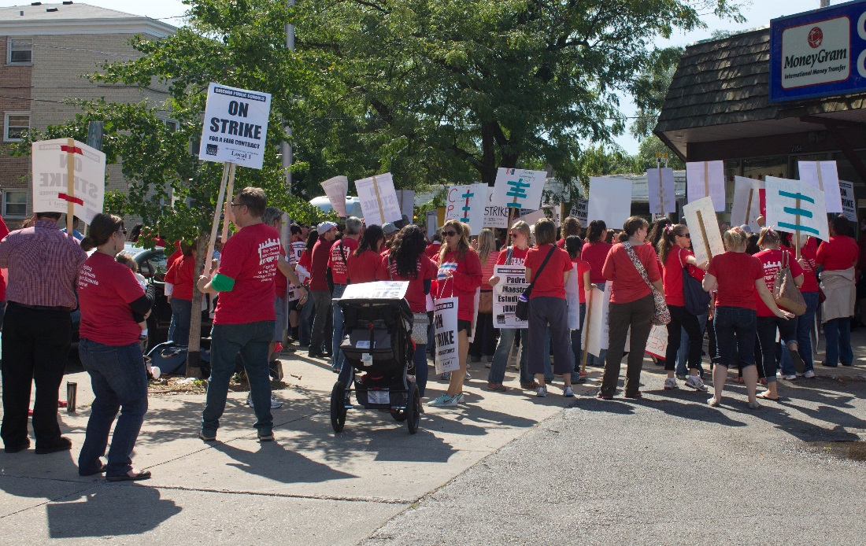
Tactics
Union
Picket
Strike
Boycott
Management
Lockout
Replacement workers
Injunction
Notes:
Picket – a protest
Strike – workers refuse to work.
Boycott – a campaign to get consumers to stop buy company products
Lockout – the opposite of a strike. Employers do not let the employees come to work
Injunction – business goes to court to force workers back.

