Slide 1
Klinger comments
This homework is well done and is easy to follow. A nice touch are the notes on some of the slides.
If I were to make any suggestions, they would be:
The policies for both companies should be on one slide for easier comparison
The manager evaluation should use bullets, not complete sentences.
Add something beyond what was asked for.
Note that this is slightly different from what I assigned.

Slide 2
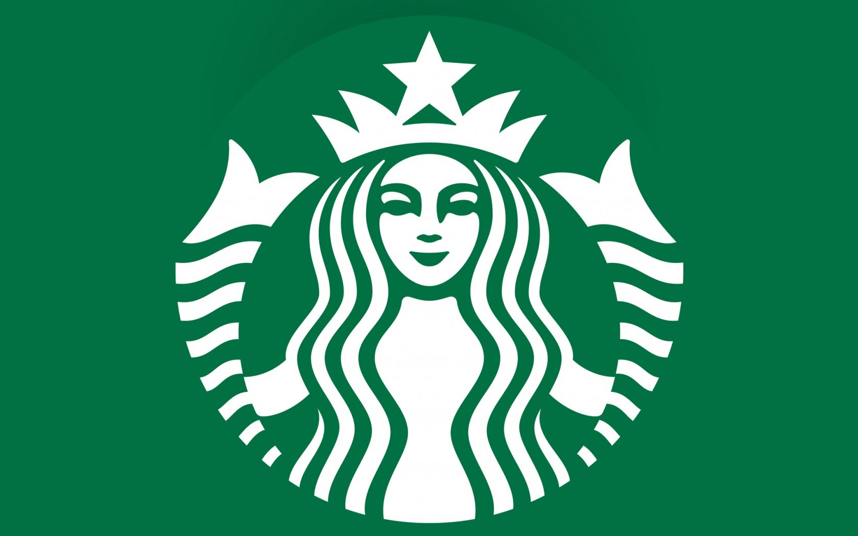
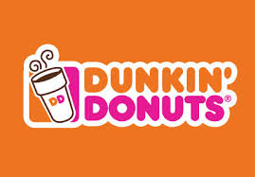
VS.
Isabella Lopreiato
Julia Schuchardt
Anthony Hsu
John DeBias

Slide 3
Company Overview- Starbucks
Originally single store in 1971
In 1981 Howard Schultz invested in the store
Currently operates 21,366 stores worldwide
2014, 11 billion income
Structurally similar to European espresso bar
“Meet me at Starbucks”
Mission Statement:
“To inspire and nurture the human spirit-one person, one cup, and one neighborhood at a time.”
Notes:
For 2014 fiscal year Starbucks reported 11 billion comprehensive income with 21,336 operating stores worldwide. Started as a single coffee house in Seattle's historic Pike Place Market., as reflected it is symbol. Howard Schultz, Starbucks’ chairman, CEO, and president, happen to walk into the store in 1980 and was drawn by the inspiration of Moby Dick theme. After spending some time in italy gaining more knowledge about the art of coffee. He came a back a year later in 1981 to invest in the store.

Slide 4
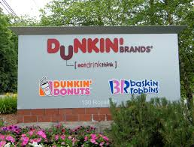
Company Overview- Dunkin Donuts
10,083 Dunkin' Donuts stores worldwide
7,015 franchised restaurants in 36 United States
3,068 international stores in 32 countries
1950-founded by William Rosenberg
Mission Statement-
"Make and serve the freshest, most delicious coffee and donuts quickly and courteously in modern, well-merchandised stores.”
Notes:
Dunkin is headquartered in Canton, Massachusetts, claiming to be “ the world’s largest coffee and baked goods chain.” While, William Rosenberg opened the first Dunkin in Quincy, MA in 1990 UK company Allied Domceq purchased the company and created the Dunkin Brand which included Baskin-Robin’s and Togo’s. In 2005 Pernod Ricard, a wine company purchased Dunkin from Allied.

Slide 5
DUNKIN OR STARBUCKS?

Slide 6
Corporate Policies-Dunkin Donuts
Among supporting government laws and regulations, DD supports:
Franchisees must follow protocols for handling food from delivery, receiving and storage, to preparation, cooking, holding, and service.
Restaurant managers must conduct monthly food safety self assessments to review any health risks from the food, along with sanitation, time, and temperature.
Restaurants must display menu board signs asking guests to inform their server of a food allergy.
They are also required to display educational allergen awareness posters in areas where the employees are.
Notes:
Universal Declaration of Human Rights
No deforestation
No development of High Carbon Stock forests/High Conservation Value areas
No burning in preparation of land or in development
Reduce Greenhouse Gas emissions on existing plantations from all sources
Animal Welfare Policy
Clean water/food
Prevent heat stress
Cage-free egg systems/gestation crate-free pork
Transported in a clean, large, enclosed areas
Should only be given antibiotics for treatment of disease
“Dolphin Safe” tuna standards
Statement on Food Safety
Follow HACCP principles, government regulations, global industry best practices, and GFSI principles.
Conduct Monthly Food Safety Self Assessments
Must display menu board signs asking guests to inform their server of allergies/educational allergen awareness posters in areas reserved for crew members

Slide 7
Corporate Policies-Starbucks
Among supporting government laws and regulations Starbucks supports:
Prohibits all forms of labor in the workplace that is harmful to children.
Prohibits forced labor for any employees.
Employees must immediately report any conduct engaged in or endured by a Starbucks partner.
The entire store must be routinely checked each day for good sanitation and hygiene. Employees with this responsibility must get payed for all of the time spent doing it.

Slide 8
Corporate Culture
Starbucks
Energetic
“Trendy”
Focused on connecting with customers
Very cohesive staff
bonded over company lingo and customer stories
Dunkin Donuts
Serious
Task-Force like staff management
Speed is key

Slide 9
Trends: Going Green
Starbucks:
Use climate smart practices at their farms
Reduced water consumption 23% over past seven years
Installed energy management systems in stores
Has a reusable cup program
Dunkin Donuts:
Gives coffee grounds to local farmers
Uses low flow plumbing fixtures
Installed sophisticated energy monitor systems in stores
Has a reusable cup program
Notes:
In the years the people have become more aware about the environment and conserving it, thus many companies have implemented green marketing such as both of these as part of sustainability and giving back.

Slide 10
Trends: Online Stores
Dunkin Donuts:
Sell K-Cup Pods
Sell coffee beans
Offers free shipping on first purchase
Offers a “regular refill” program
Starbucks:
Sell flavor syrups and sauces
Sell cocoa and chocolate
Sell appliances
Sell coffee beans
Sells to gourmet coffee drinking niche
Notes:
In order to move away from brick and mortar stores and expanded the business to meet demands and stay current with the demands of technology both stores allow to purchase their products online.

Slide 11
Trends: Store Rewards Card
Starbucks:
Offers a customer loyalty program
Has multiple levels of rewards
Has a mobile app
Offers exclusive coupons to card holders
Sell a “Sterling Silver Starbucks” card that is made of silver
Dunkin Donuts:
Offers a customer loyalty program
Offers exclusive coupons to card holders
Has a mobile app
Free to become a cardholder

Slide 12
Manager Summary
Starbucks- Whitney Chang
Early 40’s
Feeler
Conceptual skills
Shares care for business ethics with corporate office
ex: sustainable operations/ environmental care
Bureaucratic management
Instructions by higher ups are gospel
Dunkin Donuts- Lily Chung
Late 30’s
Thinker
Cares about the customer satisfaction possibly more than staff
Scientific management
Set standards of operating for staff

Slide 13
Manager Evaluation
Starbucks- Whitney Chang
Chang is a very strong personality. She can see through peoples facades and has good diagnostic skills of who would fit in her store. Chang’s weakness could be her extreme management by walking around. She is out monitoring staff to the point of it being annoying and over bearing on staff.
Dunkin Donuts- Lily Chung
Chung operates with a decentralized approach and directs a lot of attention to time management due to the time requirements during everyday operations such as the morning commuter breakfast rush. She walks the line of management and staff a little too often. She is too readily working the front as part of the team than as a leader stepping in. This weakens the image of her position as a manager to her staff.

Slide 14
Works Cited
"Dunkin' Donuts And Starbucks: A Tale Of Two Coffee Marketing Giants."Co.Create. Fast
Company, 21 Aug. 2014. Web. 09 Apr. 2015.
"Dunkin Dounuts." DunkinDonuts.com. Dunkin Donuts, n.d. Web. 09 Apr. 2015.
“Lily Chung.” Personal interview. 9 Apr. 2015
"Starbucks Coffee Company." Starbucks Coffee Company. Starbucks, n.d. Web. 09 Apr. 2015.
"Whitney Chang." Personal interview. 8 Apr. 2015.

